Slide 1
Kindergarten Consortium Session 1: Understanding Young Learners
Division of Early Childhood Services
Office of Kindergarten to Third Grade Education
Friday, February 7, 2025
Presented By Beth Wharton, K-3 Coordinator

Slide 2
NJDOE Resources
P-3 Alignment Page
Preschool Guidelines
Kindergarten Guidelines
First-Third Grade Guidelines
Expert Video Library
Approaches to Learning

Slide 3
Understanding Young Learners (1 of 5)

Slide 4
Understanding Young Learners (2 of 5)
Child development and learning that applies to five and six-year-old children.
Each child is an individual and member of a family, which allows teachers to refine decisions about how to teach and care for each child.
Each child’s social and cultural context is discernable by learning about the child’s family and the values, expectations, and factors that shape their lives at home and in their communities.

Slide 5
Understanding Young Learners (3 of 5)
The range of abilities and behaviors of young children is broad.
Students’ prior or lack of prior educational experiences may shed light on specific strengths or needs. These needs may have been identified before entering kindergarten, or they may be identified once children have entered the kindergarten classroom.
Teachers systematically assess and document any potential learning, behavioral, or physical challenges demonstrated by a child and be proactive in addressing these issues.

Slide 6
Understanding Young Learners (4 of 5)
It is critical that educators:
emphasize developmentally appropriate best practices;
incorporate New Jersey Student Learning Standards;
embed four types of assessments;
allow for a culturally responsive kindergarten classroom environment and equitable opportunities;
meet all domains to help foster children’s development; and
address the needs of all learners.

Slide 7
Understanding Young Learners (5 of 5)
Cognitive Development
Physical Activity and Movement
Language Development
Social and Emotional Learning (SEL)
Culturally Responsive Classrooms
Equity
Differentiated Instruction

Slide 8
Cognitive Development
A child’s cognitive development determines how they think, explore, and figure out things.
It refers to concepts such as memory, the ability to learn new information, and the development of knowledge, skills, problem-solving, and dispositions that allow children to think about and understand the world around them.
Cognitive skills develop as children learn to think more complexly, make decisions, and solve problems.

Slide 9
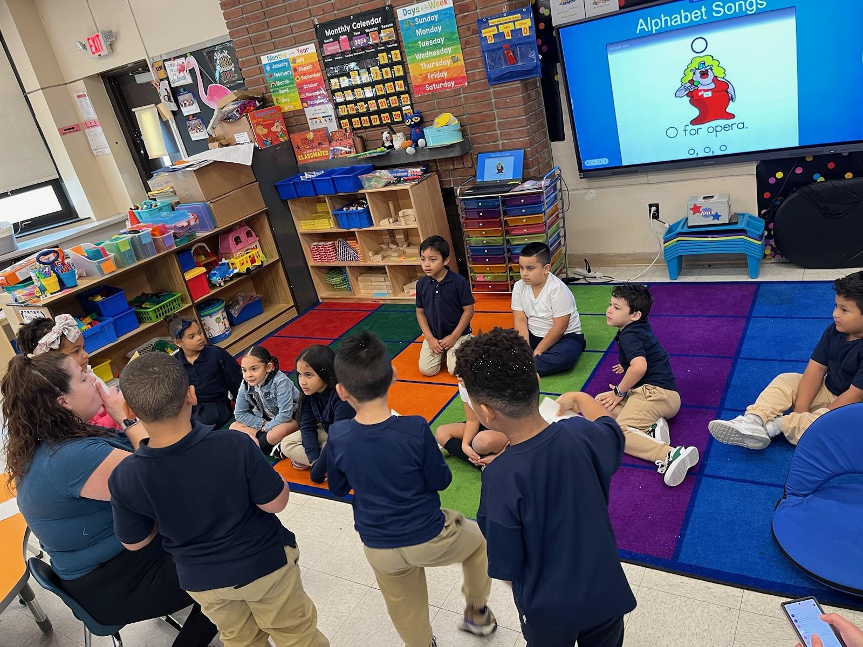
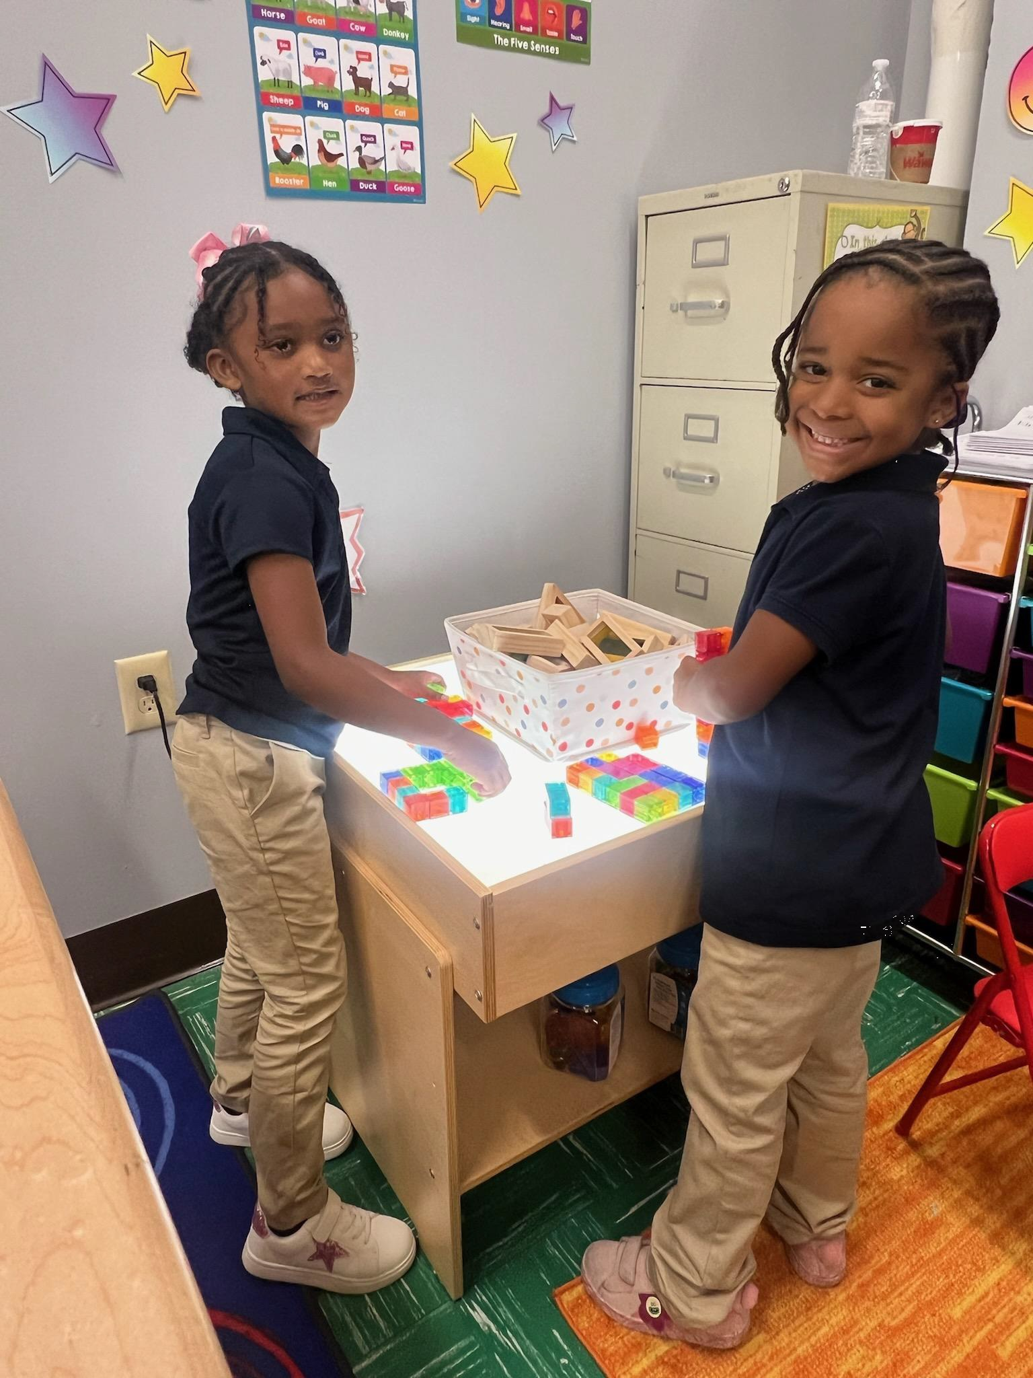
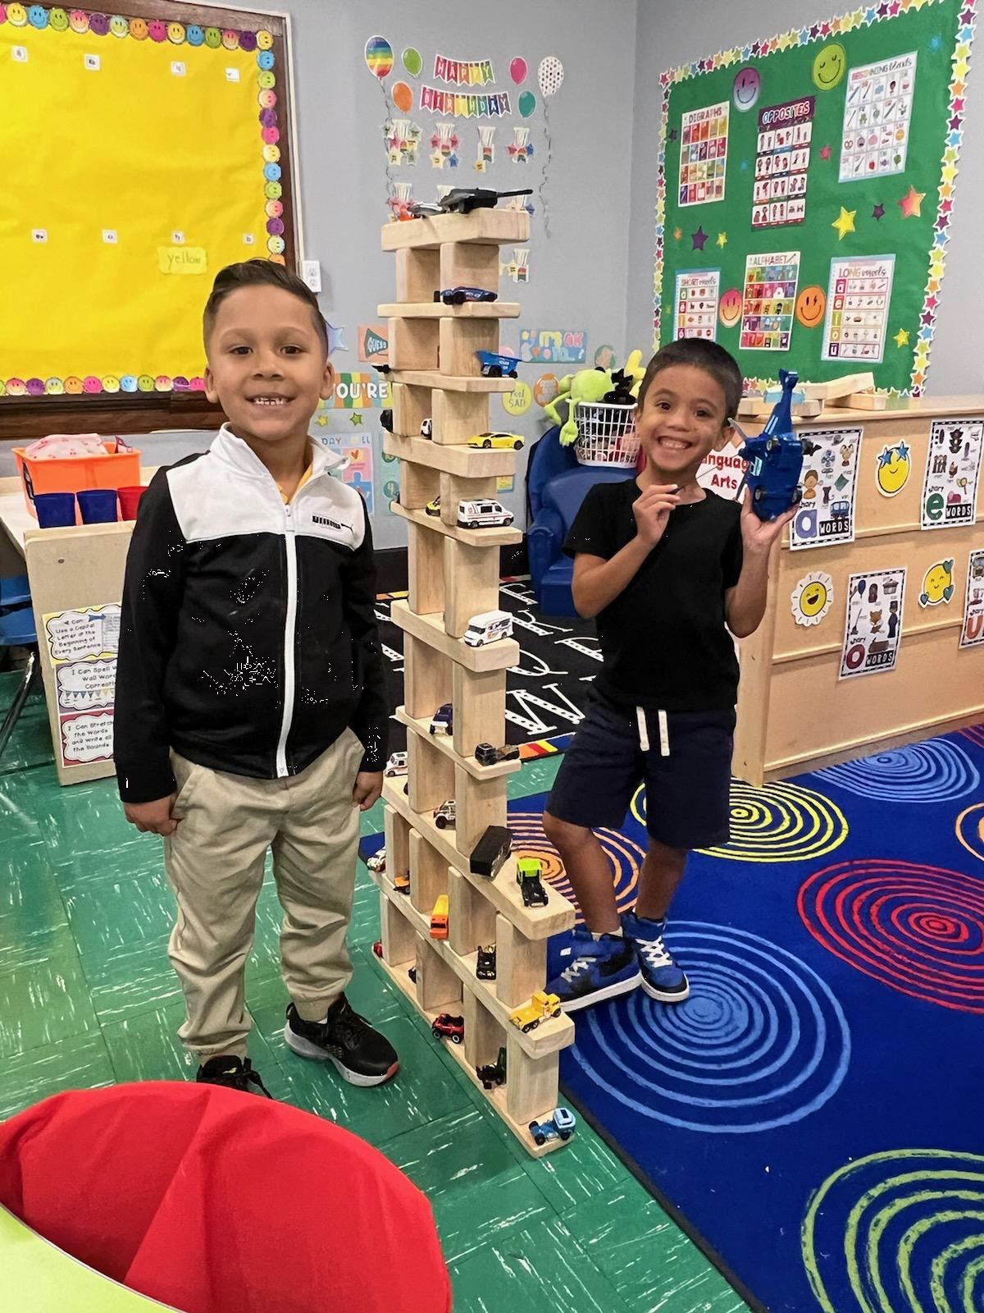
Supporting Children's Movement

Slide 10
Physical Activity and Movement
Classroom physical activity can benefit students by:
improving concentration and the ability to stay on-task in the classroom;
reducing disruptive behavior, such as fidgeting in the classroom;
encouraging motivation and engagement in the learning process; and
helping to increase academic performance.

Slide 11
Language Development (1 of 2)
A developmentally appropriate kindergarten offers children:
a variety of opportunities to interact with books, printed words, writing/ drawing and oral language;
opportunities to listen to and understand language; and
ways to use language to communicate ideas, thoughts, and feelings.

Slide 12
Language Development (2 of 2)
Language development refers to children’s emerging abilities to understand and use language.
Language skills are both receptive and expressive.
A classroom rich in spoken language and literacy will naturally improve a child’s language development (CDC, 2023).
Children are dependent on oral language skills as young children use oral language skills to learn how to read and write.

Slide 13
Social and Emotional Learning (SEL)
An integral part of education and human development.
The developmental process through which all individuals acquire and apply the knowledge, skills, and attitudes to develop their identity, manage emotions, show empathy for others, establish and maintain supportive relationships, and make responsible and caring decisions.
Schoolwide and involves ongoing planning, implementation, evaluation, and continuous improvement by all members of the school community.
Reliant upon a school climate where all students and adults feel respected, supported, and engaged.

Slide 14
Five Categories of SEL
CASEL (n.d.) lists five categories below that are interrelated areas of social and emotional development skills and competencies:
Self-awareness-the ability to understand one’s own emotions, thoughts, and values and how they influence behavior across contexts.
Self-management-the ability to manage one’s emotions, thoughts, and behaviors effectively in different situations and to achieve goals and aspirations.
Social awareness-the ability to understand the perspectives of and empathize with others, including those from diverse backgrounds, cultures, and contexts.
Relationship skills-the ability to establish and maintain healthy relationships and to effectively navigate settings with diverse individuals and groups.
Responsible decision-making-the ability to make caring and constructive choices about personal behavior and social interactions across diverse situations.

Slide 15
All About Me

Slide 16
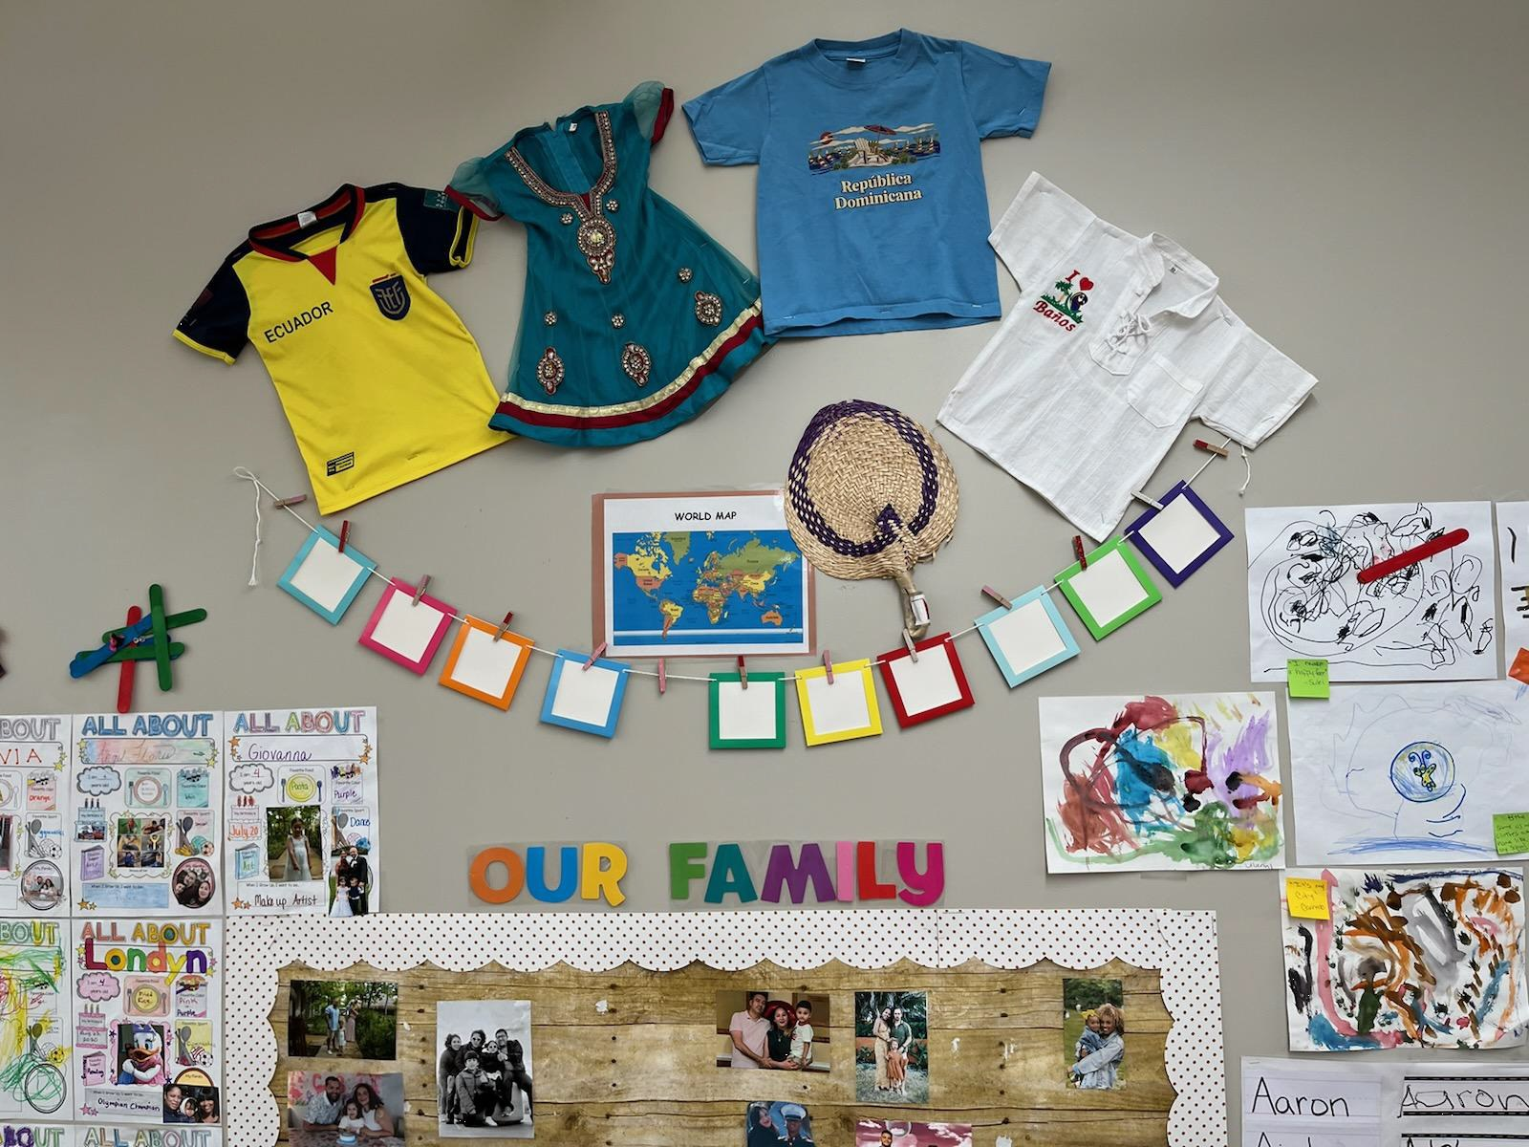
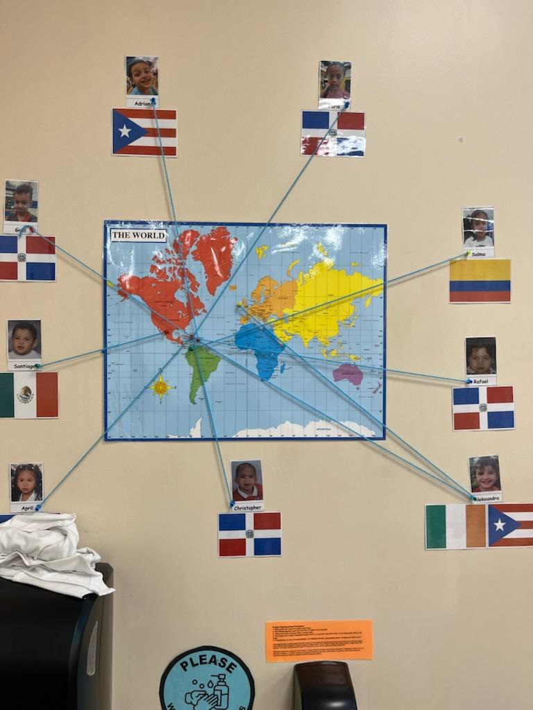
All About My Family

Slide 17
Culturally Responsive Classrooms
Promotes young children’s optimal development and learning.
High-quality kindergarten classrooms need to be developmentally appropriate to support all learners in the classroom.
The “whole child” approach to education seeks to address the individuals’ strengths, needs, and interests as they engage in learning.

Slide 18
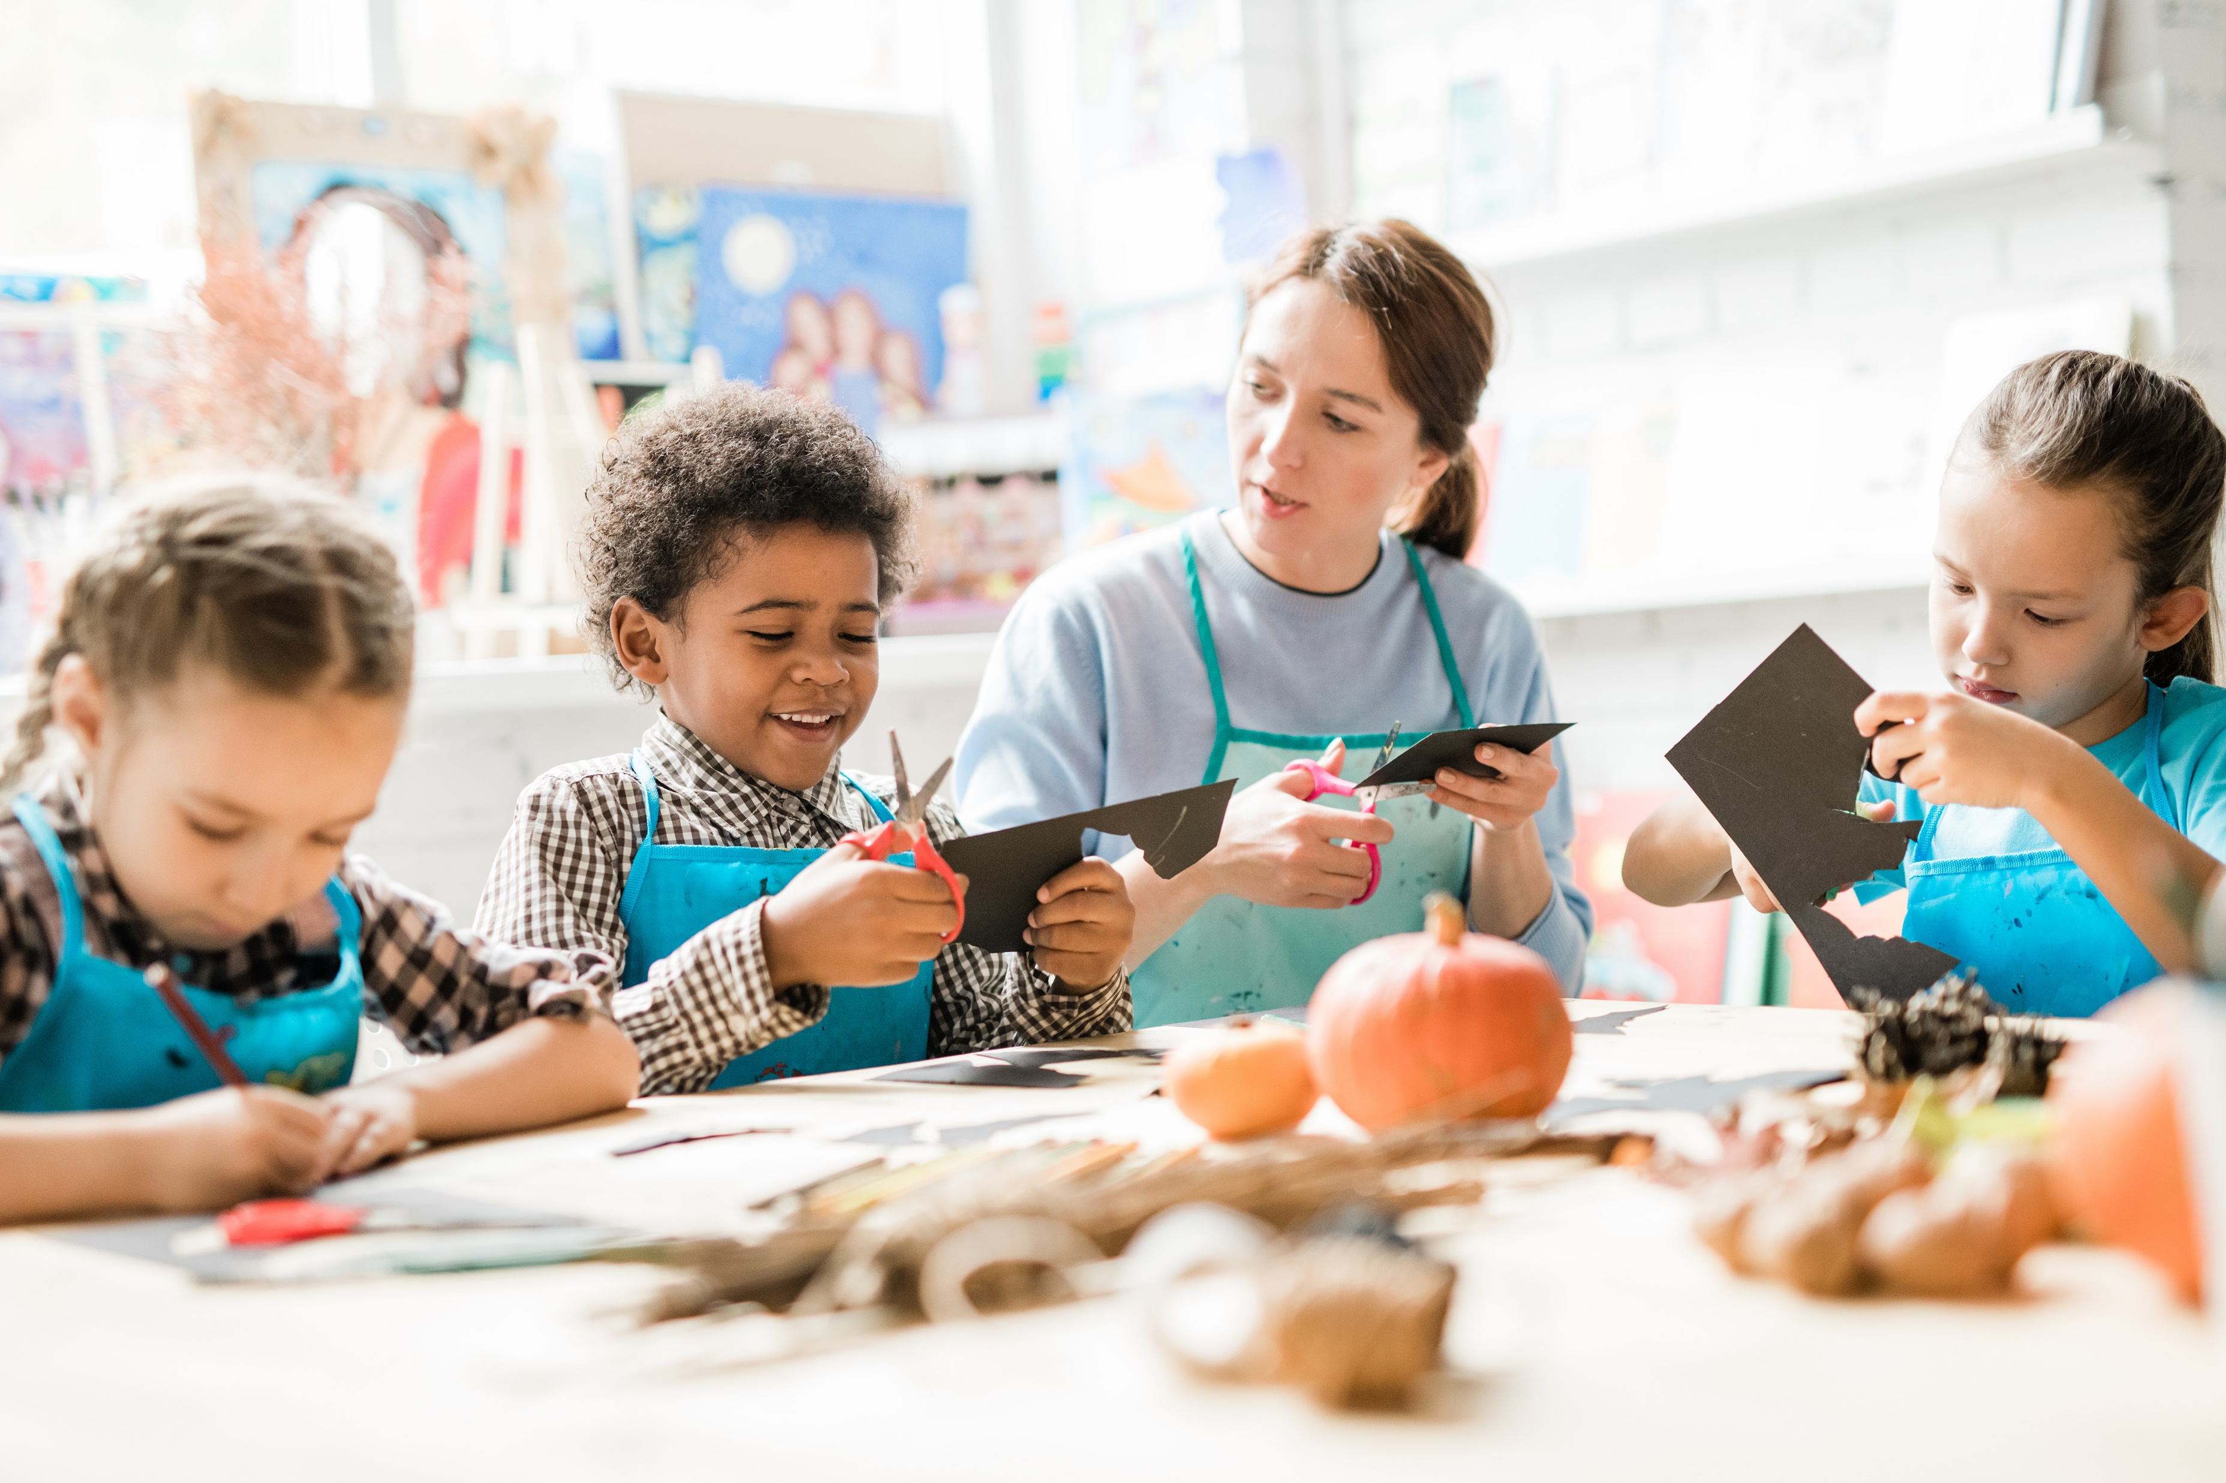
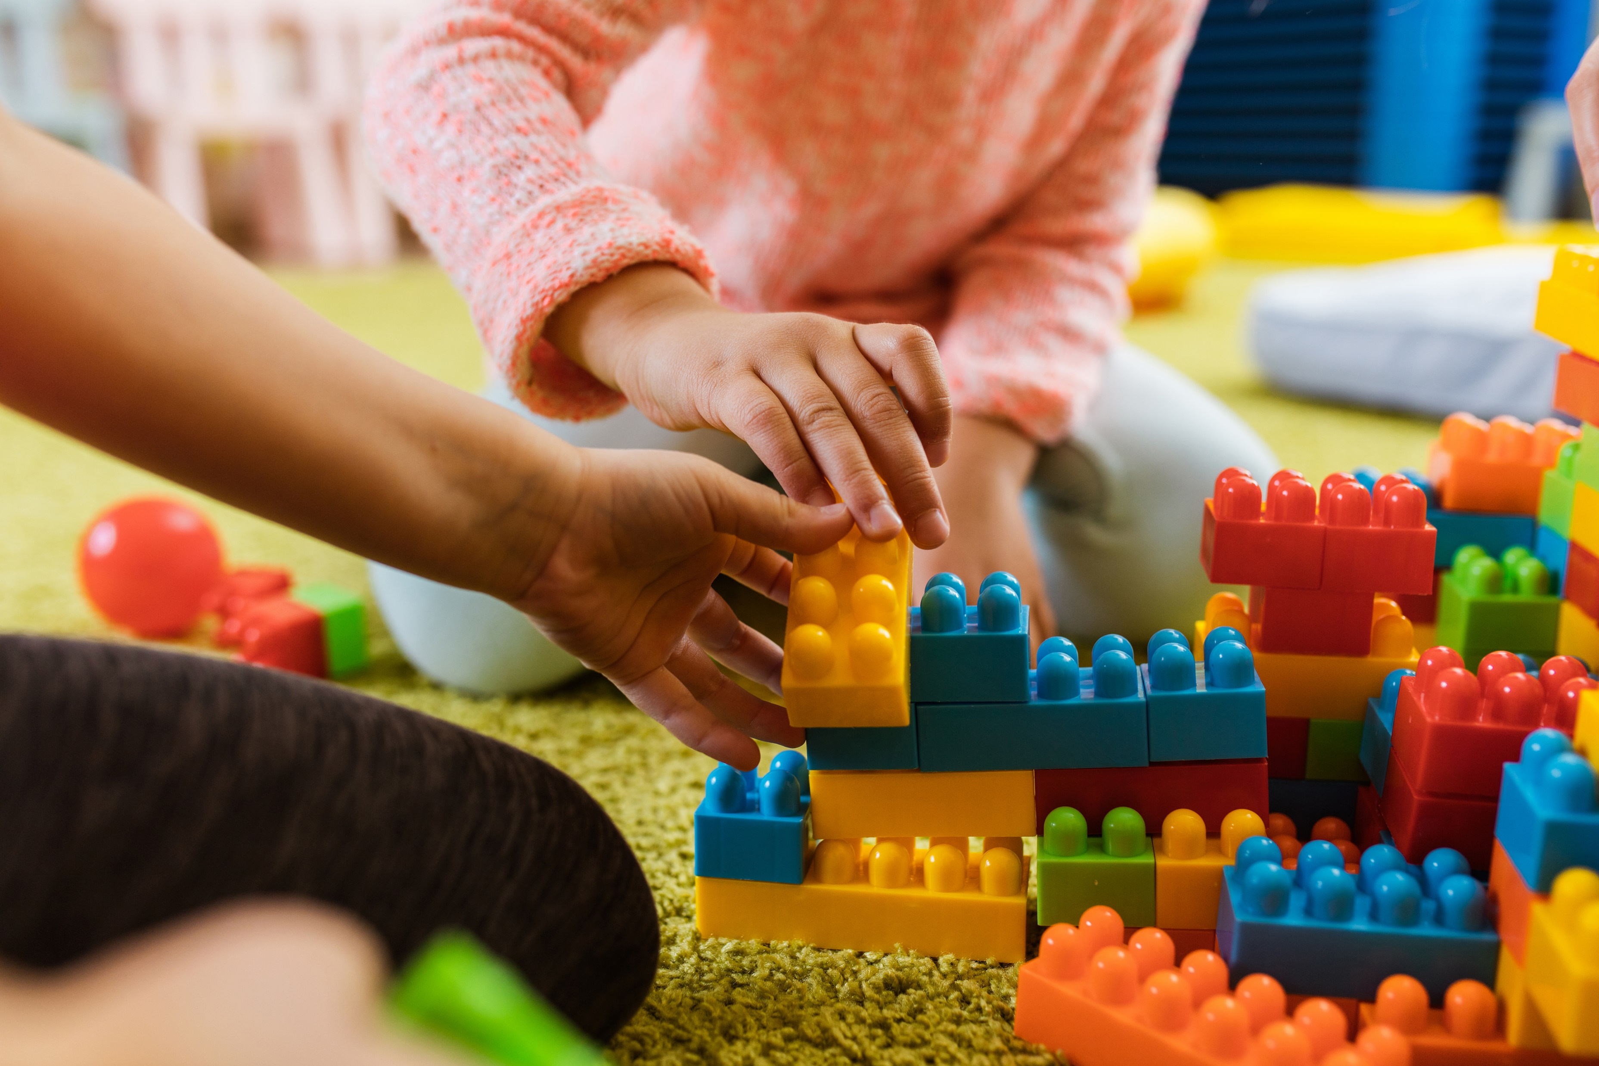
Equity in Schools

Slide 19
Advancing Equity (1 of 2)
Kindergarten children enter school with varying background experiences.
Some children enter kindergarten having experiences in a preschool or childcare environment.
For others, the kindergarten school environment is their first experience away from family.

Slide 20
Advancing Equity (2 of 2)
Early childhood educators can advance equity within their school districts. Districts should “provide high-quality early learning programs that build on each child’s unique set of individual and family strengths, cultural background, language(s), abilities, and experiences.
Research shows that attending a high-quality full-day kindergarten program can begin to close the opportunity gap (Kay & Pennucci, 2014).

Slide 21
Equitable Opportunities
Ensuring district-wide equity is a crucial part of developing a high-quality kindergarten program.
It is important for school districts to make every effort to ensure that their staff is prepared and a part of a professional learning community that focuses on advancing equity in each school environment.
In creating this community, it is important to regularly audit procedures and policies with an equity lens. This will ensure that educators are working to even the playing field for all students.
Families and community members should be included in this conversation to ensure that everyone has a voice.

Slide 22
Equity in the Classroom
Educational equity in the classroom:
ensures all students can actively engage in learning;
critical for school districts to offer opportunities for every student to learn, engage, and grow; and
Includes a district curriculum and approach that values and reflects the diverse backgrounds of the children and families in the community.

Slide 23
Differentiated Instruction
Differentiated instruction benefits all students and is considered a universal support used to modify the delivery of core or Tier 1 instruction.
Teachers can differentiate in four different categories: content, process, learning environment, and product.

Slide 24
Supporting Diverse Learners
Even when providing students with high-quality differentiated instruction to accommodate unique needs, at times students may require more intensive academic, behavioral, or social and emotional support.
These supports are provided to individual or small groups of students and are designed to address specific skills or content needs uncovered through a systematic data collection and analysis process.

Slide 25
Additional Support for Diverse Learners
Increased opportunities to provide immediate feedback to address student misconceptions.
Offering additional opportunities for students to practice skills.
At times students may require more intensive support than can be offered in a small group or one-on-one setting.

Slide 26
Reflections
What were any take aways you had from the session today and how did it connect to your work?
How will you turn-key information from Session 1: Understanding Young Learners?

Slide 27
References
Center for Disease Control and Prevention. (2023). Child development basics. U.S. Department of Health & Human Services. https://www.cdc.gov/child-development/index.html
Collaborative for Academic, Social, and Emotional Learning. (n.d.). What is social emotional learning? https://schoolguide.casel.org/what-is-sel/what-is-sel/
Freschi, E. (2023). Developmentally appropriate practice in kindergarten: Observation guide. Center to Improve Social and Emotional Learning and School Safety at WestEd.
Kay, N., & Pennucci, A. (2014). Full-day kindergarten: A review of the evidence and benefit-cost analysis (Doc. No. 14-01-2202). Washington State Institute for Public Policy.

Slide 28
Follow Us on Social Media
Facebook: @njdeptofed
Instagram: @newjerseydoe
LinkedIn: New Jersey Department of Education
Threads: @NewJerseyDOE
X: @NewJerseyDOE
YouTube: @newjerseydepartmentofeduca6565

Slide 29
Thank You!
New Jersey Department of Education: nj.gov/education
https://www.nj.gov/education/earlychildhood/
Beth.Wharton@doe.gov

